Slide 1
The Stable
Marriage Problem (SMP)
Part II

Slide 2
Plan for Today
Briefly discuss HW 5
IP formulation – with special attention to the stability constraint
Python implementation of the SMP
  utilities for data loading, better-match finding and stable-matching checking
  IP
  Gale-Shapley
Problem variations and implementation ideas

Slide 3
Solving the SMP Using Integer Programming
We have Gale-Shapley
  finds a stable matching
  does so in polynomial time:
    at each iteration, 1 man proposes to woman he hasn’t proposed to before
    → at most n x n = n² possible proposals, i.e. at most n² iterations
So why bother with IP? What do you think?
  allows for an objective function
  allows for variations in the formulation such as accounting for incomplete preferences, ties, weighted preferences, costs/budget constraints, and more

Slide 4
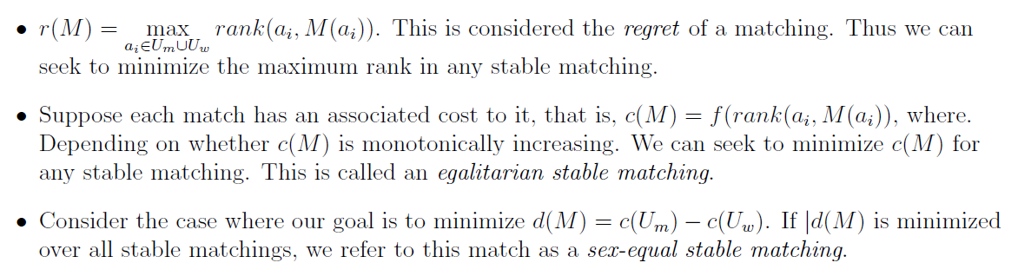
SMP IP Objective Function
SMP only seeks a feasible solution, not an optimal one. This is what is known as a constraint satisfaction problem. We will come back to this type of problem later in the semester.
We can add optimality conditions by considering several factors. Some notation:
Below are a few objective functions to consider:
U_{m} = the set of men U_{w} = the set of women a_{i} = person i | M(a_{i}) = person that a_{i} is matched to rank(a_{i}, M(a_{i})) = a_{i}’s ranking of their match M(a_{i})

Slide 5
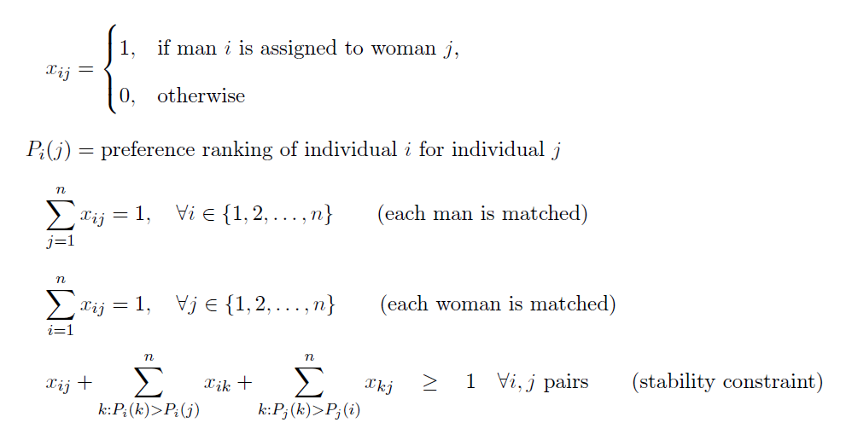
IP Formulation – take a few minutes to think about it
Note:
no objective function
Let’s walk through an example of the stability constraint on the white board.
Notes:
see notes

Slide 6
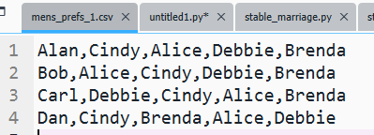
IP PuLP Implementation
we will load in the preference data from csv files – see above
smp_utils.py has some helper code we will and you can use
what data structures does the formulation need? think about it
  pairs
  k:P_{i}(k) > P_{i}(j) – translate this to English –
  The partners that i prefers to j. I made a dictionary keyed by the (i,j) pair with value being a list of the partners.
  An entry looks like {('Cindy', 'Dan'): ['Carl', 'Bob', 'Alan’], … } meaning Cindy prefers those men to Dan.
  (We will hold off on building a data structure for P_{i}(j) itself for now.)
let’s understand some of the smp_utils.py code and then fill in stable_marriage_basic_skeleton.py in spyder

Slide 7
IP PuLP Implementation: stability constraint
for pair in pairs:
man, woman = pair
better_women = better_matches[(man, woman)]
better_men = better_matches[(woman, man)]
# Either this pair is a match
constr_lhs = x[pair]
# or the man is with a woman he preferred to this woman
constr_lhs += lpSum(x[(man,better_woman)] for better_woman in better_women)
# or the woman is with a man she preferred to this man
constr_lhs += lpSum(x[(better_man,woman)] for better_man in better_men)
# Constraint insures at least 1 of the above 3 conditions is true
smp += constr_lhs >= 1, f'Stability constr. for {man} and {woman}'

Slide 8
IP PuLP Implementation
Solution:
Matches:
Alan Cindy Bob Alice Carl Debbie Dan Brenda
Status: Optimal
Stable matching? True
It ran the function smp_utils.is_it_stable – see that code.

Slide 9
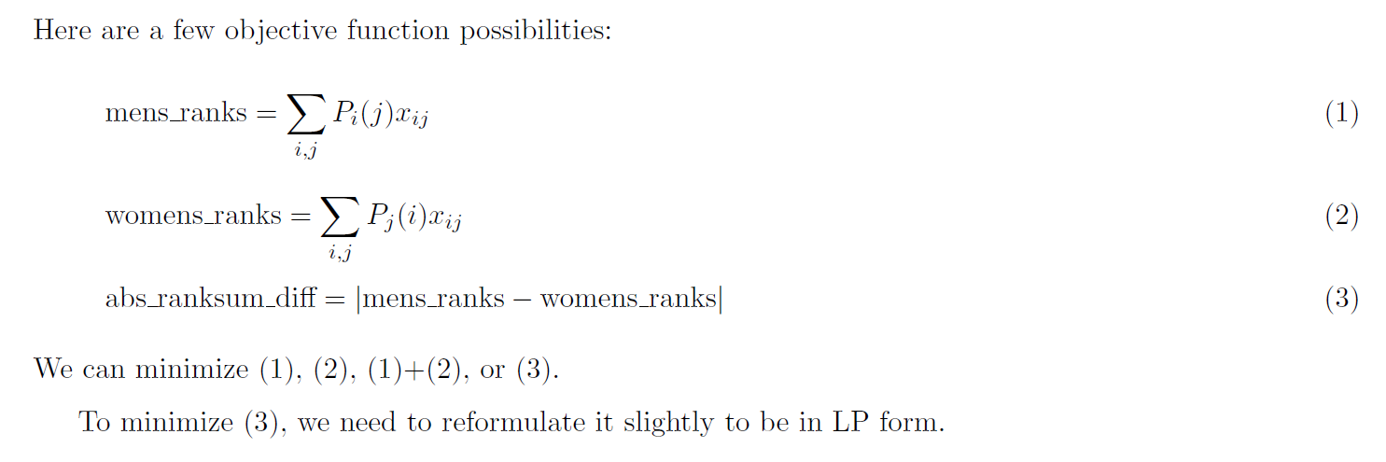
Implement an Objective in the IP
Now we will need a data structure for P_{i}(j).
We can use smp_utils.prefs_to_ranks.

Slide 10
Example usage of prefs_to_ranks
prefs_dict
Out[77]:
{'Alan': ['Cindy', 'Alice', 'Debbie', 'Brenda'],
'Bob': ['Alice', 'Cindy', 'Debbie', 'Brenda'],
'Carl': ['Debbie', 'Cindy', 'Alice', 'Brenda'],
'Dan': ['Cindy', 'Brenda', 'Alice', 'Debbie'],
'Alice': ['Dan', 'Carl', 'Alan', 'Bob'],
'Brenda': ['Carl', 'Dan', 'Alan', 'Bob'],
'Cindy': ['Carl', 'Bob', 'Alan', 'Dan'],
'Debbie': ['Dan', 'Bob', 'Carl', 'Alan']}
rank_dict = prefs_to_ranks(prefs_dict)
rank_dict
Out[79]:
{('Alan', 'Cindy'): 1,
('Alan', 'Alice'): 2,
('Alan', 'Debbie'): 3,
('Alan', 'Brenda'): 4,
('Bob', 'Alice'): 1,
('Bob', 'Cindy'): 2,
etc.

Slide 11
Implementing an Objective
Let’s:
  minimize (1) + (2)
  minimize (2) only
Some code to add (can create a stable_marriage_intermed.py file):
ranks = prefs_to_ranks(prefs_dict) # this is P_i(j)
…
men_ranks = lpSum(ranks[man,woman] * x[man, woman] for man in men for woman in women)
women_ranks = lpSum(ranks[woman,man] * x[man, woman] for man in men for woman in women)
smp += women_ranks #+ men_ranks # or uncomment men_ranks

Slide 12
Some new code for results display
print('\nRanks men received -')
for m in matched_vars:
r = get_rank_of_match(m,prefs_dict)
print(f'{m[0]} ranked {m[1]} {r}')
print('Sum = ',value(men_ranks))
print('\nRanks women received -')
for m in matched_vars:
r = get_rank_of_match(m[-1::-1],prefs_dict)
print(f'{m[1]} ranked {m[0]} {r}')
print('Sum = ',value(women_ranks))

Slide 13
Results
No objective
Ranks men received -
Alan ranked Cindy 1
Bob ranked Alice 1
Carl ranked Debbie 1
Dan ranked Brenda 2
Sum = 5
Ranks women received -
Cindy ranked Alan 3
Alice ranked Bob 4
Debbie ranked Carl 3
Brenda ranked Dan 2
Sum = 12
Minimize women ranks objective
Ranks men received -
Alan ranked Alice 2
Bob ranked Debbie 3
Carl ranked Cindy 2
Dan ranked Brenda 2
Sum = 9
Ranks women received -
Alice ranked Alan 3
Debbie ranked Bob 2
Cindy ranked Carl 1
Brenda ranked Dan 2
Sum = 8

Slide 14
Gale-Shapley (G-S) Implementation
Implement yourself as an exercise, or
find good code and test it carefully
Time permitting – let’s run some G-S code in class

Slide 15
Variations/Extensions
one-sided (or single-sided) matchings
  assign a set of entities to a second set of entities when those in the first set have preferences over those in the second set, but not vice versa.
  example applications – pupils to schools, residents to housing, etc.
  tentative plans for a Coast-Guard-related guest lecture on this subject in early March
college admission (and related)
  no longer a 1:1 matching, now assign n_{i} students to each of m universities
  how would we model this? could we create a G-S-like algorithm?
  see Erasmus lecture reference on D2L
Notes:
See https://arxiv.org/pdf/2101.00579#:~:text=A%20one%2Dsided%20matching%20problem,N%20want%20to%20be%20assigned.

Slide 16
Variations/Extensions (cont)
Generalizations:
  forbidden pairs
  indifference (i.e. ties allowed)
  incomplete lists
  imbalanced, e.g. n men, n’ women, and n ≠ n’
  single set with preferences, e.g. the “stable roommates problem”
  auction component – participants “bid” for partners
  many more…
This is a very rich problem with connections to graph theory, economics, computer science, and more and a vast number of applications.

